Slide 1
AFRICA DAY Wilson Centre, Washington DC 25th May 2018
Remarks by:
Dr. Donald Kaberuka
AU High Representative
For Financing the Union & Peace Fund

Slide 3
Acknowledgment
Author: KEITH LOWE, 2012
Viking, Penguin Books

Slide 9
INTRA REGIONAL TRADE
 | % OF TOTAL
EU | 63.6
ASEAN | 24.2
SADCC | 20.6
EAC | 20.3
MERCOSUR | 13.0
ECOWAS | 10.6
COMESA | 10.2
AMU | 4.1
CEMAC | 3.1
ECCAS | 1.8
Gains p.a = 16Bn
+ Trade = 30% - 42%

Slide 10
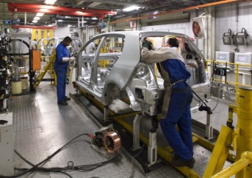
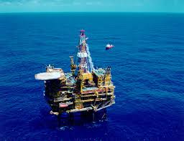
WHAT IT IS

Slide 11
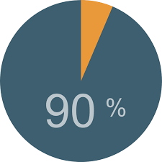
WHAT IT IS NOT

Slide 12
CONCERNS
DUMPING JOBS RULES OF ORIGIN | REVENUE LOSS
DISPUTE RESOLUTION SAFE GUARDS | INFANT INDUSTRY TRANSITIONAL MEASURES
TAKEN CARE OF

Slide 13
SENSITIVE

Slide 14
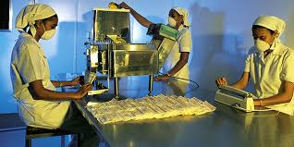
EXCLUDED

Slide 15
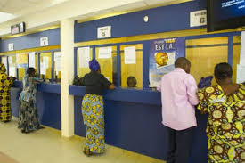
SERVICES

Slide 16
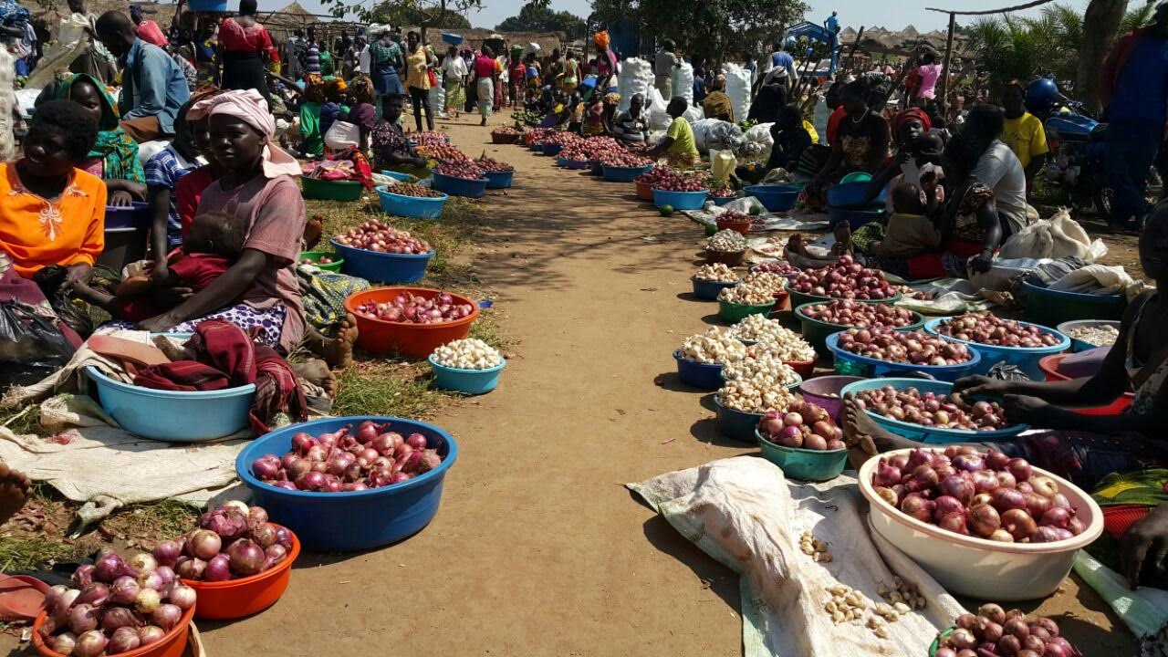
WHY NOW

Slide 17
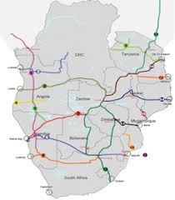

Slide 18
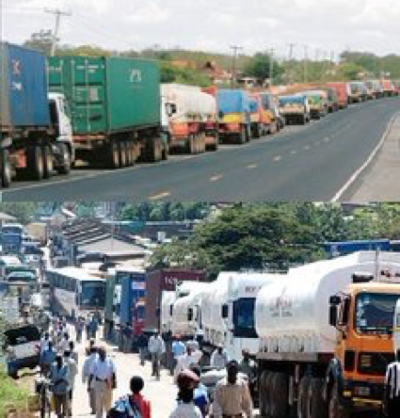
COMPLEMENTARY MEASURES

Slide 19
CONTEXT

Slide 20
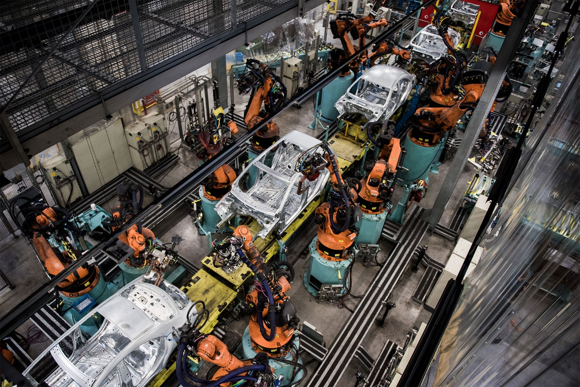

Slide 21
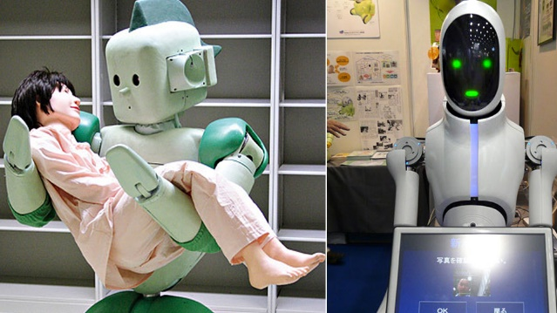

Slide 22
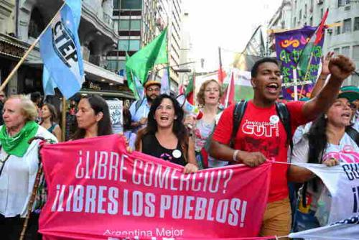
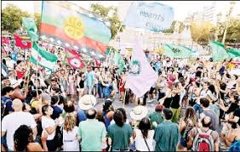
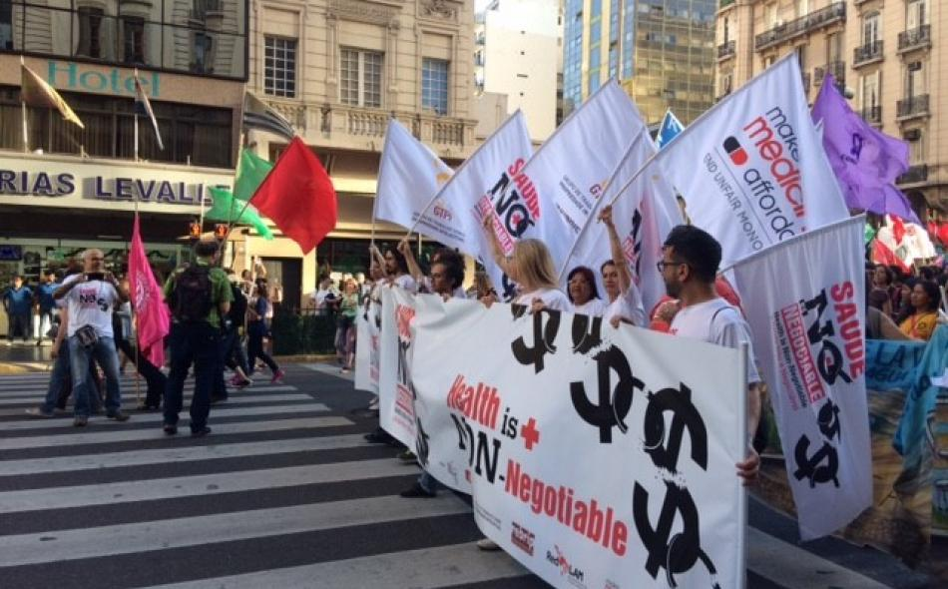

Slide 23
CONTEXT

