Slide 1
THE NEW FACE OF THE MEXICAN VOTER
The 2012 Presidential Election

Slide 2
What Went Wrong with the Polls?

Slide 3
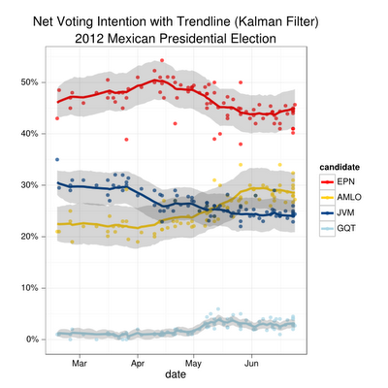
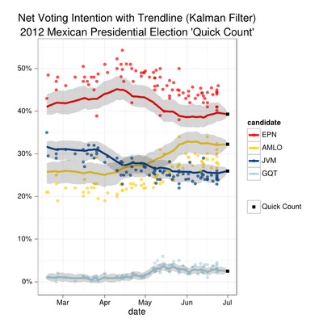
Poll of Polls and campaign dynamics
Source: Diego Valles’ Blog

Slide 4
The Polls
ALL POLLS SHOW THE SAME TREND: EPN IN FIRST PLACE, AMLO IN SECOND AND JVM IN THIRD
THEY SHOW HOW AMLO REACHED JVM IN MAY AND SURPASSED HER
TWO WEEKS BEFORE THE ELECTION PRACTICALLY ALL POLLS HAVE AT LEAST A DOUBLE-DIGIT LEAD FOR EPN. NO EVIDENCE OF A CONSPIRACY.
IT IS VERY UNLIKELY THAT ALL POLLS WERE WRONG. SO, WHAT HAPPENED?

Slide 5
A New Law
NEW LAW: FOR THE FIRST TIME SINCE 1988, ALL POLITICAL PARTIES HAD TO APPEAR SEPARATELY IN THE BALLOT, EVEN IF SOME OF THEM NOMINATED THE SAME CANDIDATE. THERE WERE FOUR CANDIDATES AND SEVEN PARTISAN CHOICES. MOREOVER, PEOPLE COULD CHOOSE ALL THE PARTIES THAT NOMINATED THE SAME CANDIDATE AND THEIR VOTE WOULD COUNT.
IN THE PAST, PARTIES NOMINATING THE SAME CANDIDATE APPEARED UNDER A SINGLE COALITION NAME. IN 2006 THE BALLOT HAD ONLY 5 CHOICES (CALDERÓN, MADRAZO, LÓPEZ OBRADOR, PATRICIA MERCADO AND ROBERTO CAMPA) EVEN IF THE NUMBER OF PARTIES WAS EIGHT. IT WAS A BALLOT THAT BASICALLY MEASURED CANDIDATE STRENGTH.
THE NEW LAW CREATED UNFORESEEN AND UNPREDICTED MEASUREMENT ISSUES. BASICALLY A NIGHTMARE IF YOU ARE ORTHODOX AND TRY TO MEASURE THE ELECTORAL CHOICE USING A SIMULATED PAPER BALLOT.
I DON´T THINK ANY PREELECTORAL POLL WAS ABLE TO MEASURE ACCURATELY THE ACTUAL RESULTS.

Slide 6
Official Results by party*
Source: IFE
Votes for Coalitions 15.5%
*Excluding votes for Non-registered candidates and null votes

Slide 7
Official Results and Exit Poll by candidate
Source: IFE and Buendía & Laredo
Official Results*
Exit Poll**
*Excluding votes for Non-registered candidates and invalid votes
**Excluding Non-response

Slide 8
Exit Poll by party*
Source: Buendía & Laredo
AND EXIT POLLS WERE ACCURATE BECAUSE THE RECENCY OF THE VOTE ALLOWED IT TO CAPTURE CANDIDATE STRENGTH BUT SOME PARTIES WERE OVERESTIMATED.
Votes for Coalitions 7.8%
*Excluding Non-response

Slide 9
The Polls
WHY SOME PREELECTORAL POLLS DID BETTER THAN OTHERS? THOSE WHO DID NOT USE A SIMULATED BALLOT AND RATHER PRESENTED VOTERS WITH A FOUR-CANDIDATE CHOICE PROBABLY MEASURED BETTER EACH CANDIDATE´ S STRENGTH.
THOSE WHO USED A SIMULATED BALLOT PROBABLY EVOKED A MORE PARTISAN ANSWER, PARTICULARLY WHEN THERE WAS A GOOD DEAL NUMBER OF VOTERS (19-25%) WHO WERE DOUBTFUL ABOUT WHICH CANDIDATE TO SUPPORT. WHEN ELECTION DAY WAS NOT CLOSE THE DIVERGENCE BETWEEN A SIMULATED BALLOT AND A CANDIDATE-CHOICE ITEM WAS PROBABLY NOT VERY LARGE. THINGS GOT DIFFERENT DURING THE LAST DAYS OF THE CAMPAIGN AND OBVIOUSLY ON ELECTION DAY.
THE ORTHODOXY OF USING A SIMULATED PAPER BALLOT DID NOT PAY OFF. WE HAVE TO ABANDON THIS PRACTICE, ESPECIALLY IN A CANDIDATE-CENTERED AGE AND WHEN DEALING WITH ELECTIONS TO AN EXECUTIVE POSITION. IN MID-TERM ELECTIONS WILL BE MORE PLAUSIBLE TO USE THE SIMULATED PAPER BALLOT.
IN THE U.S. POLLS DO NOT TRY TO REPLICATE THE ACTUAL BALLOT AND POLLS SEEM TO WORK FINE.

Slide 10
THE NEW FACE OF MEXICAN VOTERS, 2012

Slide 11
Age and sex
Exit Poll vs registered voters figures

Slide 12
Vote choice by sociodemographics
Exit Poll Estimates

Slide 13
Presidential Approval
Do you approve or disapprove of the job Felipe Calderón is doing as President of Mexico?

Slide 14
Direction of country
All in all, do you think things in the nation are generally headed in the right direction, or do you feel that things are off on the wrong track?

Slide 15
Economic Growth or Crime Issues?
Between promoting economic growth or reducing insecurity, which one do you think it should be the top priority?

Slide 16
Strategic vote
Would you say that you voted for the candidate closest to your own positions or would you say you voted for a candidate to avoid the victory of some other candidate?
 | Votó por el candidato que más se acerca… | Votó para evitar que otro candidato ganara
Josefina Vázquez Mota | 25.9 | 26.2
Enrique Peña Nieto | 40.2 | 37.1
Andrés Manuel López Obrador | 31.9 | 32.3
Gabriel Ricardo Quadri | 2.0 | 4.4
Total | 100 | 100

Slide 17
Vote choice by Social Network
 | Facebook | Twitter | E-mail | YouTube
Josefina Vázquez Mota | 27.4 | 26.9 | 27.8 | 26.8
Enrique Peña Nieto | 32.4 | 32 | 31.3 | 30.1
Andrés Manuel López Obrador | 36.8 | 38 | 37.8 | 39.6
Gabriel Quadri de la Torre | 3.4 | 3.1 | 3.1 | 3.5
Total | 100 | 100 | 100 | 100

Slide 18
Split-Ticket voting
Exit Poll Estimates
Straight: 87.4%
Split-ticket: 12.6%
 | PAN | Compromiso por México (PRI-PVEM) | Movimiento Progresista (PRD-PT-MC) | Nueva Alianza | Total
Josefina Vázquez Mota | 22.6 | 1.8 | 1.4 | 0.4 | 26.2
Enrique Peña Nieto | 1.6 | 35.5 | 1.6 | 0.4 | 39.2
Andrés Manuel López Obrador | 2.0 | 2.1 | 27.7 | 0.5 | 32.3
Gabriel Ricardo Quadri de la Torre | 0.2 | 0.3 | 0.2 | 1.5 | 2.3
Total | 26.4 | 39.7 | 30.9 | 2.9 | 100.0

