Slide 1
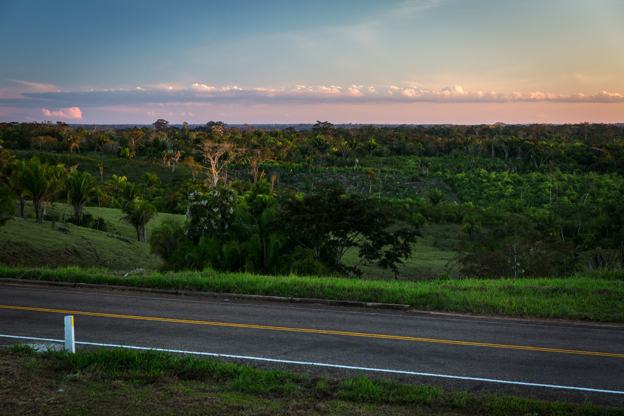

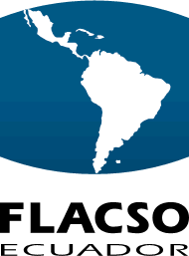
Standardizing Sustainable Development?
Development Banks in the Andean Amazon
Rebecca Ray
April 18, 2018

Slide 2

Project Overview: Research question
To what extent have international DFIs, national governments, and civil society deployed environmental and social safeguards to ensure that infrastructure projects bring shared economic benefits to nations while mitigating risks to ecosystems and communities?
Does China’s approach lead to different outcomes?
What lessons for China given they are increasingly major players in the Andean Amazon?

Slide 3
Project Overview: 6 Regional and Country Studies
Area | Authors | Scope of Analysis
Regional | Kevin P. Gallagher and Fei Yuan, Boston Univ. | Comparative typology of ESRM strategies across international DFIs active in the region
Regional | Rebecca Ray, Boston Univ. | Statistical analysis of deforestation surrounding infrastructure projects
Bolivia | Lykke Andersen, Susana del Granado, Agnes Medinaceli, Miguel Antonio Roca, INESAD | Case studies of three highways: La Paz-Oruro (CAF), Montero-Yapacaní (IADB), San Buenaventura-Ixiamas (World Bank)
Brazil | Julie Klinger, Boston Univ. | Case study of the Stonipë Ioway ecotourism project (BNDES, Fundo Amazonia)
Ecuador | María Cristina Vallejo, Betty Espinosa, and Francisco Venes, FLACSO-Ecuador | Case studies of two dams: Baba Multipurpose Dam (IADB initially, though this participation was later cancelled) and Coca-Codo Sinclair Dam (China ExIm Bank)
Peru | Juan Luis Dammert Bello, Univ. del Pacífico | Case studies of the CVIS Highway (CAF) and the Inambari Dam (cancelled, though originally expected to be financed through BNDES)

Slide 4
Project Overview: 3 Major Findings
The Andean Amazon is currently experiencing an infrastructure surge, characterized by:
  A rising share for Chinese banks, with deferential ESRM.
  Significant environmental degradation, social conflict, and economic costs.
National governments and DFIs have largely fallen short in three key areas:
  Meaningful engagement of stakeholders
  Comprehensive environmental planning
  Mechanisms for transparency and accountability
Improving outcomes will require mutually-reinforcing networks of support between DFIs and governments.

Slide 5
Environmental and Social Impacts of Infrastructure Projects in the Andean Amazon

Slide 6
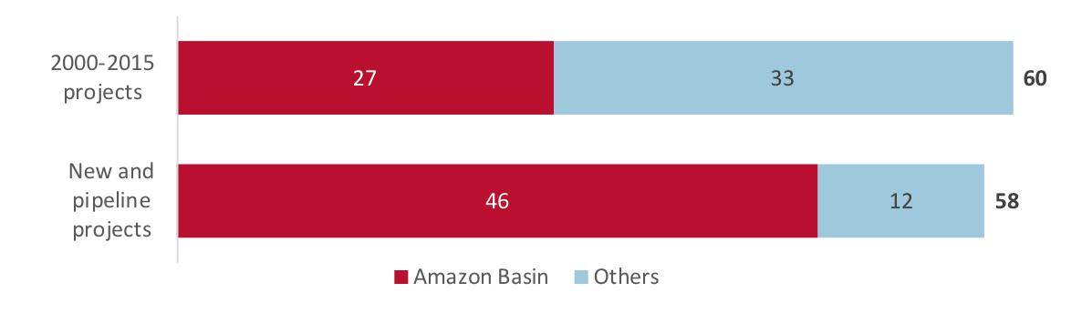
DFI-Financed Infrastructure Surge
Projects moving into the Amazon basin
Findings:
Projects appear to be accelerating and shifting toward the Amazon basin.
Chinese policy banks – with more passive ESRM approaches – are increasingly important:
  2000-2015: 6 total, 3 in the Amazon basin.
  New and pipeline: 14, all in the Amazon basin.
International DFI-Financed Infrastructure Projects in Ecuador, Peru, and Bolivia

Slide 7
International DFIs: 4 “Shades of Green”
DFIs vary based on their use of national or harmonized standards, and whether they offer concessional finance to reach those standards
 | National recognition | Conditional harmonization
Capability deference | Quadrant 1: “light green” BNDES CDB CHEXIM | Quadrant 2: “yellow green” IFC IIC US EXIM
Capability enhancement | Quadrant 3: “blue green” CAF | Quadrant 4: “dark green” IADB IBRD

Slide 8
DFI-Financed Infrastructure: Environmental impacts
Case studies: Most projects had significant impacts, two triggered cancellation
Country | Project | DFI | Environmental Damage
Ecuador | Baba dam | IADB¹ | Elevated heavy metal reservoir contamination from nearby plantation runoff and affected fish stocks, both to an unknown extent as studies ceased despite a continued mandate for them.
 | Coca-Codo Sinclair dam | CHEXIM | Sedimentation, reduced water flow, and reduced fish stocks downstream, including at the San Rafael waterfall
Peru | CVIS highway, routes 2-4 | CAF | Widespread deforestation and water contamination from informal mining settlements enabled by the road
 | Inambari dam | BNDES² | Project cancelled amidst protests regarding heavy expected deforestation and community displacement
Bolivia | Rurrenbaque – San Buenaventura bridge | IBRD | IADB participation cancelled after a formal grievance was filed alleging an inadequate EIA
 | Montero-Yapacaní highway | IADB | Uncontrolled deforestation, despite specific IADB requirements for a flora census and relocation of affected fauna
 | TIPNIS highway | BNDES | BNDES participation cancelled amidst protests regarding its impact on nature preserves
Note: ¹ The Baba dam project was initially financed by the IADB, which later cancelled that participation. ² The Inambari Dam was initially announced as a BNDES-supported project, but as the project itself was cancelled, BNDES participation was never formalized.

Slide 9
DFI-Financed Infrastructure: Social conflict
Despite ESRM differences, all projects triggered social conflict
Country | Project | DFI | Social Conflict Trigger(s)
Ecuador | Baba dam | IADB¹ | Community displacement Inadequate replacement of old livelihoods Less water available for well-dependent households
 | Coca-Codo Sinclair dam | CHEXIM | Fewer local jobs than expected Unsafe working conditions
Peru | CVIS highway, routes 2-4 | CAF | Community displacement and water contamination from new informal mining settlements
 | Inambari dam (cancelled) | BNDES² | Community displacement
Bolivia | La Paz – Oruro highway | CAF | Low quality and lack of safety of final road
 | Montero – Yapacaní highway | IADB | Unpaid workers and subcontractors from contractor abandonment of project
 | San Buenaventura – Ixiamas highway | IBRD | Unpaid workers and subcontractors from contractor abandonment of project
Note: ¹ The Baba dam project was initially financed by the IADB, which later cancelled that participation. ² The Inambari Dam was initially announced as a BNDES-supported project, but as the project itself was cancelled, BNDES participation was never formalized.

Slide 10
DFI-Financed Infrastructure: Economic cost
Despite ESRM differences, most projects experienced difficulty from lacking due diligence
Country | Project | DFI | Result
Ecuador | Baba dam | IADB¹ | Project had to be re-designed, and lost its IADB financing, after a successful legal challenge to its environmental license.
Peru | CVIS highway, routes, 2-4 | CAF | Cost overruns stemming from rushed feasibility stage
 | Inambari dam | BNDES² | Cancelled – and four others shelved – amidst protests regarding inadequate social and environmental planning
Bolivia | Montero – Yapacaní highway | IADB | Unsatisfactory progress due to an inability to renegotiate the budget for rising materials cost
 | San Buenaventura – Ixiamas highway | IBRD | Paralyzed project because the Bolivian government has not held the contractor accountable for their debts upon leaving, nor found a replacement
Note: ¹ The Baba dam project was initially financed by the IADB, which later cancelled that participation. ² The Inambari Dam was initially announced as a BNDES-supported project, but as the project itself was cancelled, BNDES participation was never formalized.

Slide 11
The Infrastructure Surge in the Andean Amazon
Regional analysis

Slide 12
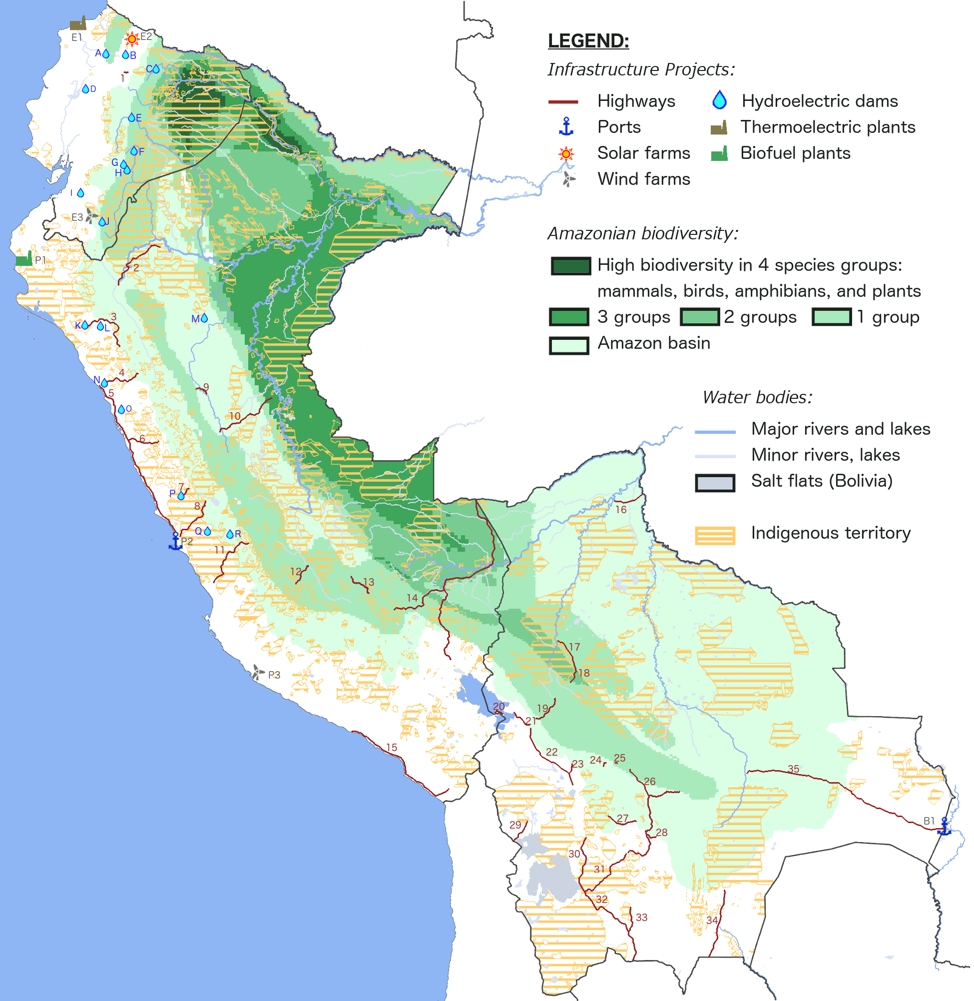
DFI-Financed Infrastructure, 2000-2015
Chinese projects are all Ecuadorean power projects
DAMS: A. Manduriacu (BNDES) B. San José de Minas (CAF) C. Coca Coda Sinclair (CHEXIM) D. Baba (IDB) E. San Francisco (BNDES, CHEXIM) F. Abanico (WB)
G. Sopladora (CAF, CHEXIM) H. San Bartolo (CAF) I. Minas San Francisco (CDB)
J. Sabanilla (WB) K. Cerro Mulato (WB) L. Las Pizarras (CAF) M. El Sauce (WB) N. Moche (WB) O. Tanguche (WB) P. Cheves (IFC) Q. Túnel Graton (WB)
R. Canchayllo (CAF).
ROADS: 1. Ruta Viva (CAF) 2. Reposo-Saramiriza (CAF) 3. Chongoyape-Cajamarca (CAF, WB) 4. Trujillo-Huamacucho (CAF) 5. Pativilca-Trujillo (CAF)
6. Casma-Huaraz (CAF) 7. Churín-Oyón (CAF) 8. Canta-Lima (WB) 9. Tocache- Dv. Tocache (CAF) 10. Tingo María-Pucallpa (CAF) 11. Lunahuaná -Chupaca (CAF) 12. Quinua-San Francisco (WB) 13. Ollantaytambo-Quillabamba (CAF, WB)
14. CVIS,Tramos 2-4 (CAF) 15. Camaná-Tacna (CAF) 16. Riberalta-Guayamerín (CAF) 17. Rurrenbaque-Yucumo (IDB) 18. Yucumo-Quiquibey (IDB) 19. La Paz-Caranavi (IDB) 20. Tiquina-Copacabana (WB) 21. Huarina-Rio Seco (WB)
22. La Paz-Oruro (WB) 23. Caracollo-Colquiri (CAF) 24. Quillacollo-Suticollo (CAF) 25. Sacaba-Chinita (CAF) 26. La Y de Integración (CAF) 27. Chacapuco-Ravelo (CAF) 28.Yamparáez-Sucre (WB) 29. Huachacalla-Pisiga (CAF) 30. Uyuni-Cruce Condo K (CAF) 31. Uyuni-Potosí (CAF) 32. Uyuni-Tupiza (CAF)
33. Integración Sur, Fase 2 (CAF) 34. Yacuiba-Boyuibe (WB) 35. Yacuiba-Puerto Suárez (CAF, IDB).
OTHER: E1. Termoesmeraldas (CDB) E2. Gransolar (CAF) E3. Villonaco (CDB)
P1. Biocombustible Maple Inc. (IDB) P2. Callao Muelle Norte (IFC) P3. Marcona-Tres Hermanas (CAF, IDB) B1. Puerto Aguirre (IFC).

Slide 13
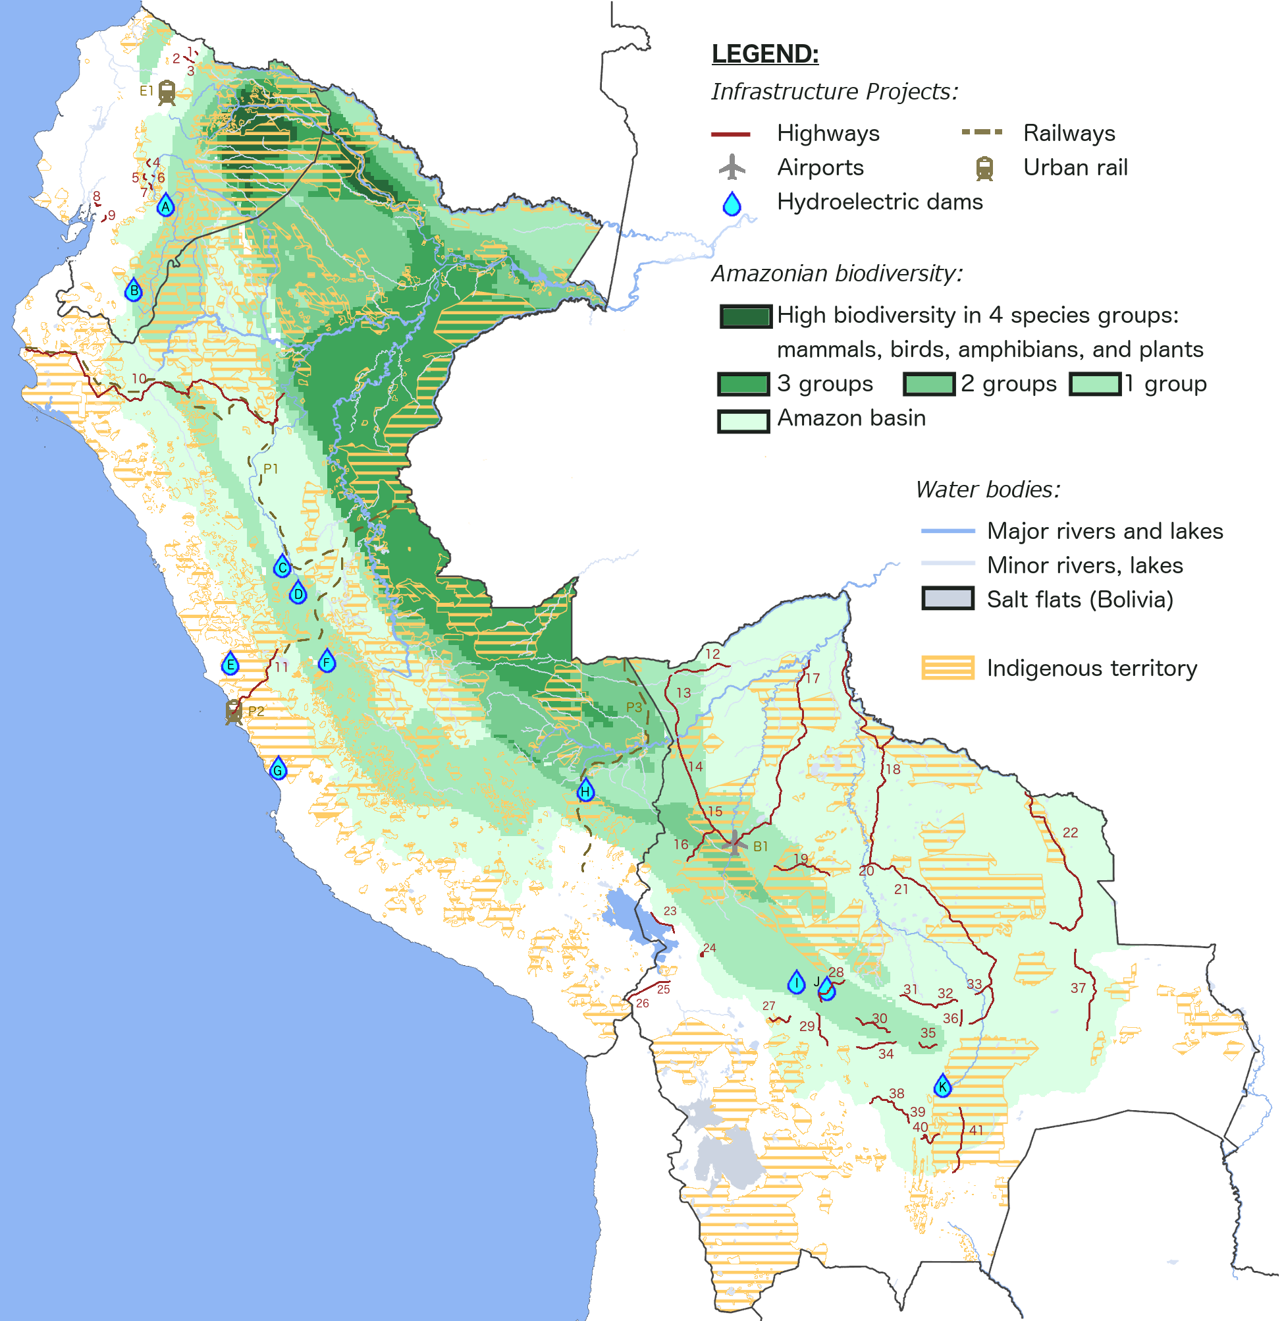
DFI-Financed Infrastructure, New and Pipeline
More China-financed projects in pipeline– especially the Bolivian Amazon
DAMS: A. Normandía (IIC) B. Delsitanisagua (CDB) C. El Carmen and 8 de Agosto (IIC) D. Chaglla (IDB) E. Yarucuya (IIC) F. La Virgen (CAF) G. Hidrocañete-Nuevo Imperial (IIC) H. San Gabán III (CDB) I. Misicuni (IDB) J. San José (CAF) K. Rositas (CHEXIM).
ROADS: 1. San Gabriel-Puente Chamizo (IDB) 2. Piquiucho-Vic. de Pusir (IDB)
3. San Rafael-Monteolivo (IDB) 4. Sigsipamba-Urbina (IDB) 5. S. Bernardo-Urbina (IDB) 6. Tulabug-Gualgalan (IDB) 7. Guamote-Guantug (IDB) 8. V. Fátima – Taura (IDB) 9. Naranjal-Jesús María (IDB) 10. Paita-Yurimaguas (CAF, IADB) 11. Lima-Canta-Unish (IDB) 12. Puerto Rico-Porvenir (CAF) 13. Porvenir-Chive (China TDB) 14. Chive-Ixiamas (China TBD) 15. Ixiamas-San Buenaventura (WB) 16. Charazani-Tumupasa (China TBD) 17. Riberalta-Rurrenbaque (CHEXIM) 18. Trinidad-Puerto Guayaramerín-Río Mamoré (China TBD) 19. San Borja-San Ignacio de Moxos (CAF) 20. Trinidad-Puerto Varador (WB) 21. Cocota-Trinidad-San Javier (WB) 22. Santa Rosa-Piso Firme (China TBD) 23. Achacachi-Escoma (IDB) 24. La Paz-El Alto (IDB) 25. Nazacara-Santiago de Machaca (IDB) 26. Santiago de Machaca-Hito IV (IDB)
27. Confital-Bombeo (CAF) 28. Colomi-Villa Tunari (CHEXIM) 29. Tarata-Toro Toro (CAF) 30. Espinaza-Comarapa (CAF) 31. Puente Yapacani-Puente Ichilo (CAF, IDB) 32. Montero-Yapacani (IDB) 33. Okinawa-Los Troncos (IDB) 34. La Palizada-Villa Granado (CAF) 35. Mairana-Bermejo (IDB) 36. Santa Cruz-Warnes (CAF) 37. San Jose-San Ignacio (WB) 38. Tarabuco-Padilla (CAF) 39. Padilla-El Salto (CAF)
40. Monteagudo-Ipati (CAF) 41. El Espino-Boyuibe (CHEXIM).
OTHER: E1. Quito Metro (CAF, EIB, WB) P1. FETAB Rail (China TBD) P2. Lima Metro (AFD, CAF, IDB, WB) P3. FETRAS Rail (China TBD) B1. Rurrenbaque Airport (WB).

Slide 14
DFI-Financed Infrastructure: Environmental Impacts
The land surrounding these projects experienced 4 times the deforestation as the rest of the countries
Note: “Areas near projects” is defined as territory immediately surrounding infrastructure projects, where the tree cover loss is demonstrably related to the project itself, as measured by a uniform algorithm applied to all projects. This range varies between one and 13 kilometers for the various projects. For more information, see Ray (2018).

Slide 15
Benefits of ESS: Deforestation Isn’t Inevitable
Where either governments or DFIs have required prior consultation, less deforestation has occurred
Note: “Areas near projects” is defined as territory immediately surrounding infrastructure projects, where the tree cover loss is demonstrably related to the project itself, as measured by a uniform algorithm applied to all projects. This range varies between one and 13 kilometers for the various projects. For more information, see Ray (2018).

Slide 16
Limitations of Safeguards
DFIs and governments have fallen short in 3 areas:
Stakeholder engagement
  Including indigenous and non-indigenous communities
Comprehensive environmental planning
  Planning for indirect as well as direct risks
  Considering impacts of an entire project, not just segments
Transparency and accountability
  Clear commitments on employment and investment
  Public, transparent bidding and contractor selection
  Continued environmental and labor monitoring, land titling

Slide 17
CVIS Highway, Routes 2-4
Inambari Dam
Peru

Slide 18
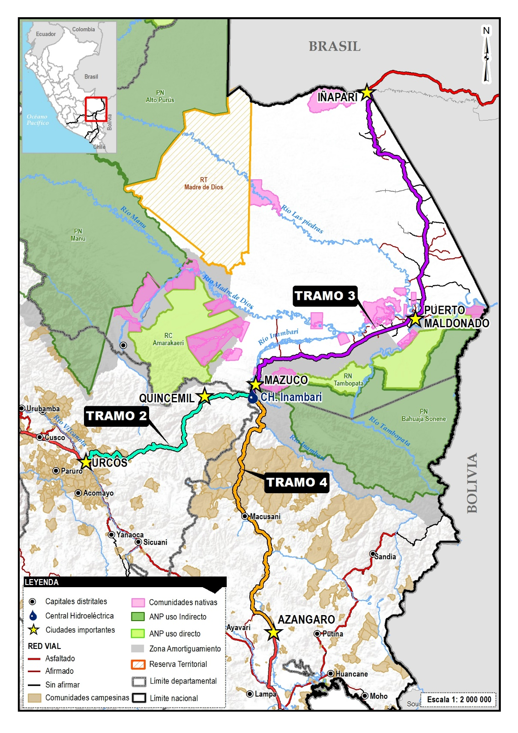
Introduction
South Interoceanic Highway, segments 2, 3 and 4 (CAF and the Peruvian state)
Inambari Dam (not built, expected funding from BNDES)
The dam would have flooded 100km of the highway
The role of ESS and how effective they were to guarantee sustainable development

Slide 19
The South Interoceanic Highway
Emblematic IIRSA project in Peru
Wide local and national support to the project; negative impacts warned by experts
Funded by CAF and the Peruvian government
Decisions made in a rush
From USD 902 M to at least USD 2002 M
Emblematic case in the Lava Jato corruption scandal

Slide 20
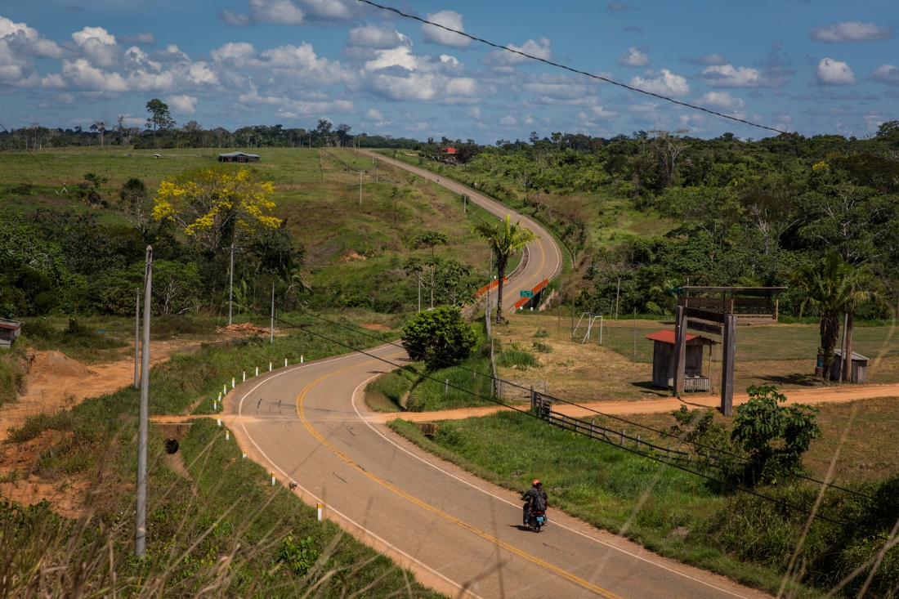

Slide 21
Environmental Safeguards in CVIS
Project exempted from assessment mechanism in Peru (SNIP)
CAF contributed to strengthening of relevant state offices
Environmental Impact Assessments – after decisions were made; divided by segments and in sub-segments to accelerate construction
Strategic Environmental Assessment – started several years after, never approved
Indirect impacts mitigation programs: CAF-INRENA (USD 17 M) and MINAM-CAF (USD 25 M)
Mitigation program launched by constructors, iSur

Slide 22
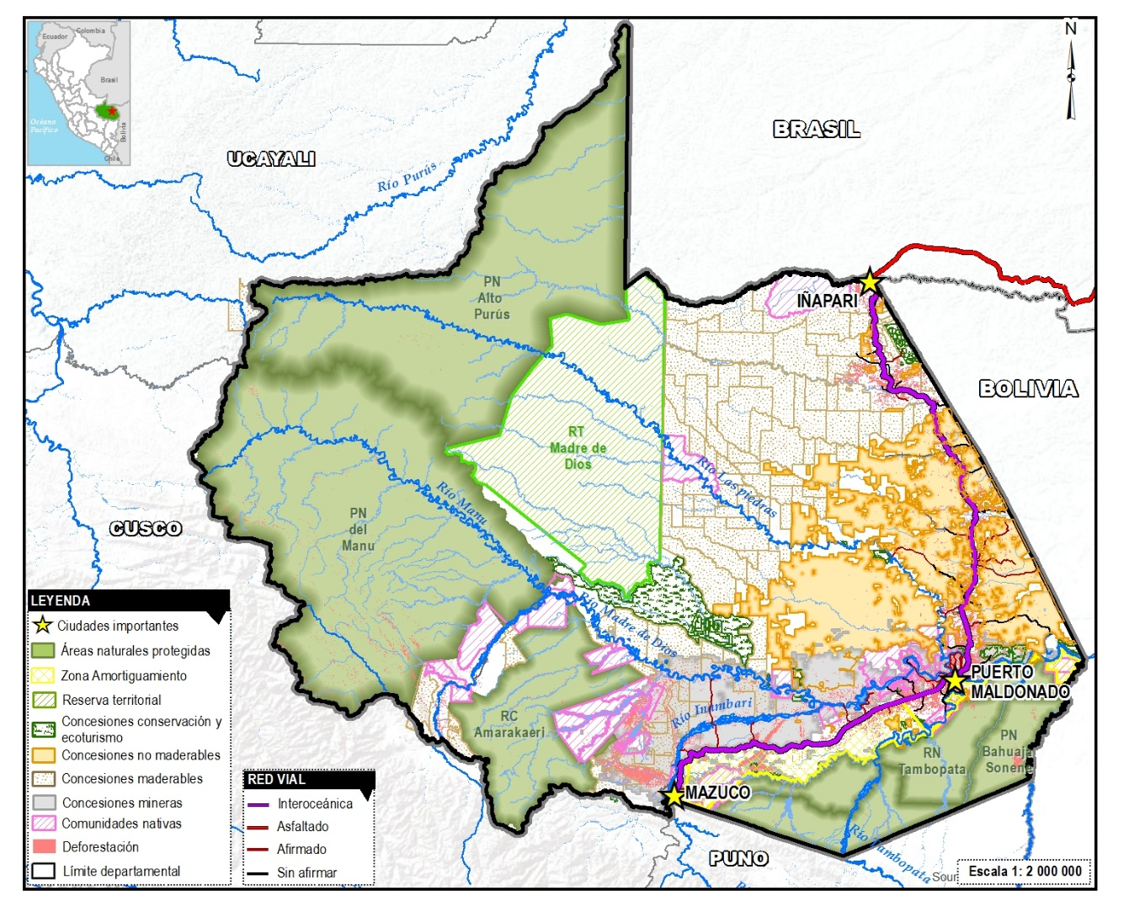
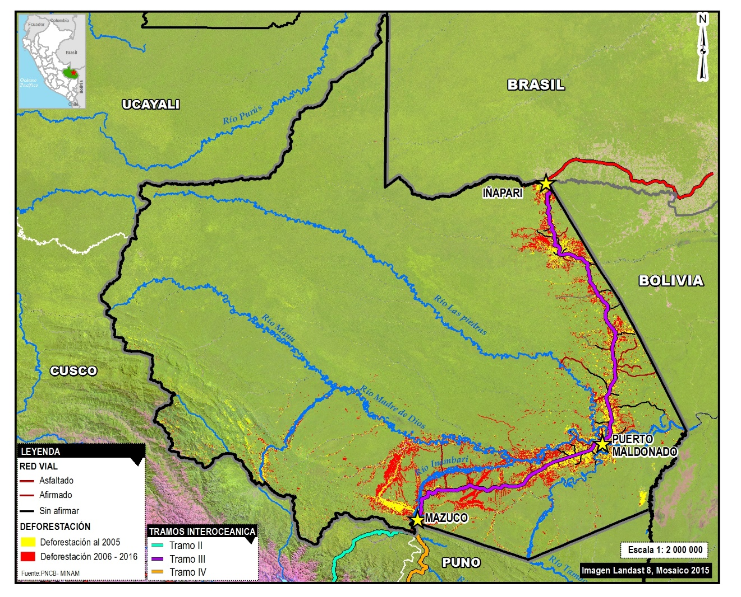
Deforestation in Madre de Dios

Slide 23
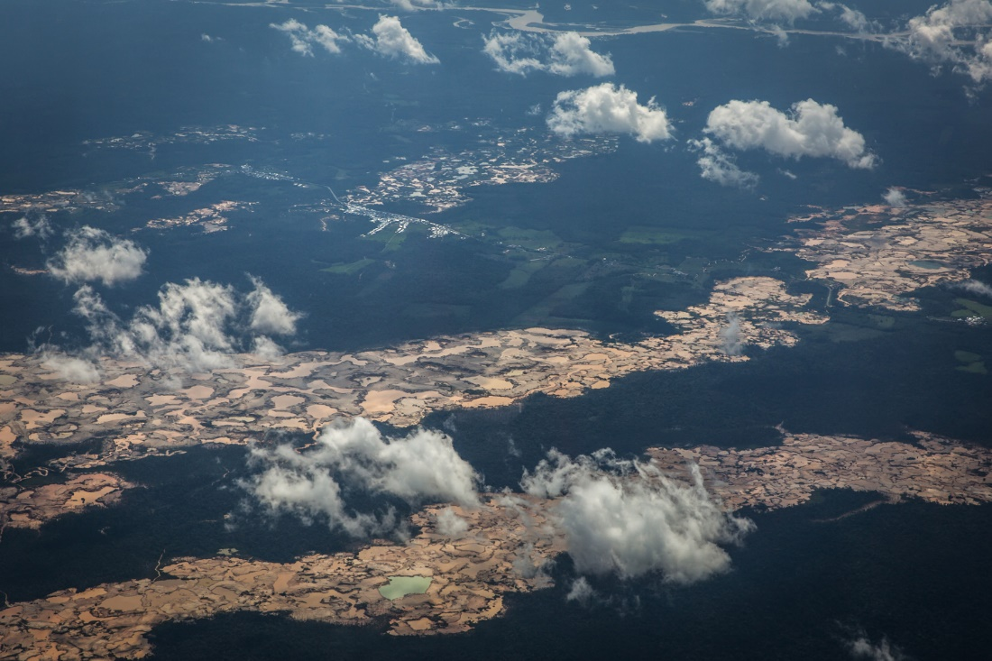
Illegal gold mining
Photo: Diego Perez

Slide 24
The Inambari dam – not built
Emblematic case in the frame of the “Peru-Brazil Energy Agreement”
Expected finance from BNDES
USD 4,900 M (expected cost)
Would have flood approximately 40,000 hectares and 100km of the interoceanic highway
Social protests boicotted the participation process of the EIA
The project was cancelled

Slide 25
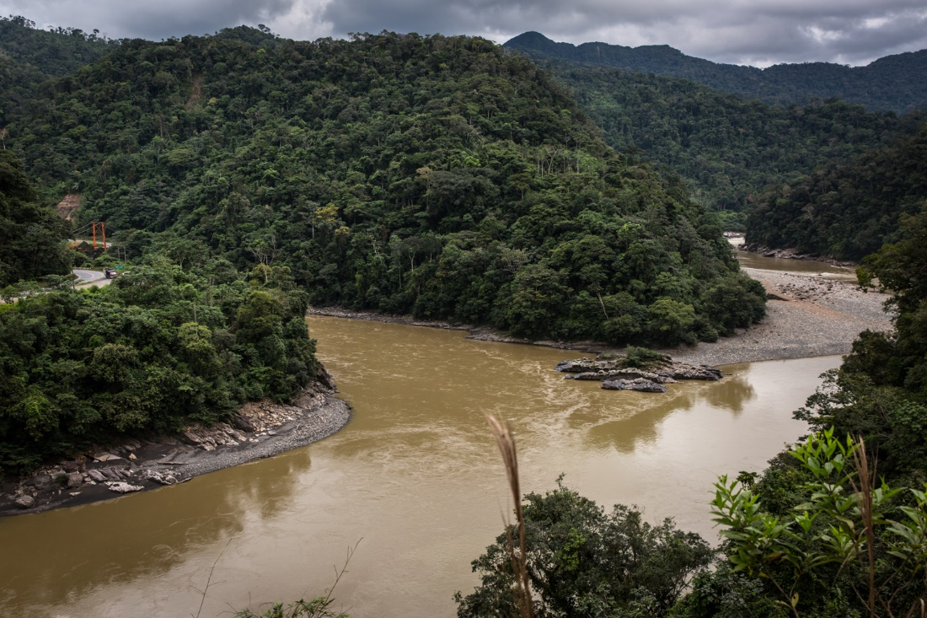
Photo: Diego Perez

Slide 26
Conclusion
Evidences of corruption, rush in implementation and outcomes suggest that construction was the main purpose, rather than development
Importance of support coalitions to implement projects
Safeguards are insufficient when:
  they have no voice in projects’ decision making processes
  Navigated by weak institutions
Non-comprehensive and posterior EIAs fail to safeguard the environment and local people’s livelihoods

Slide 27
Lessons Learned
Projects should have comprehensive social and environmental assessments before decisions are made
Development Banks should not fund nor facilitate projects implemented in a rush
Weak institutional capacities will deliver weak environmental and social outcomes
Projects should incorporate lessons learned from past projects

Slide 28
Coca-Codo Sinclair and
Baba Dams
Ecuador

Slide 29
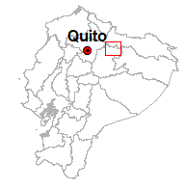


Coca Codo Sinclair Hydroelectric Project
Capacity: 1,500 MW
Annual generation: 8,734 GWh
Construction: Sinohydro
Implementation: CocaSinclair
Financing: China Eximbank
Total Cost: $ US 2,851 million
Affected zone: Napo River Basin, Coca River. Provinces of Napo and Sucumbíos (Amazonia), 3 km² flooded.
SENAGUA (2017)
Notes:
una zona de transición entre la Sierra y la Amazonía ecuatorianas.

Slide 30
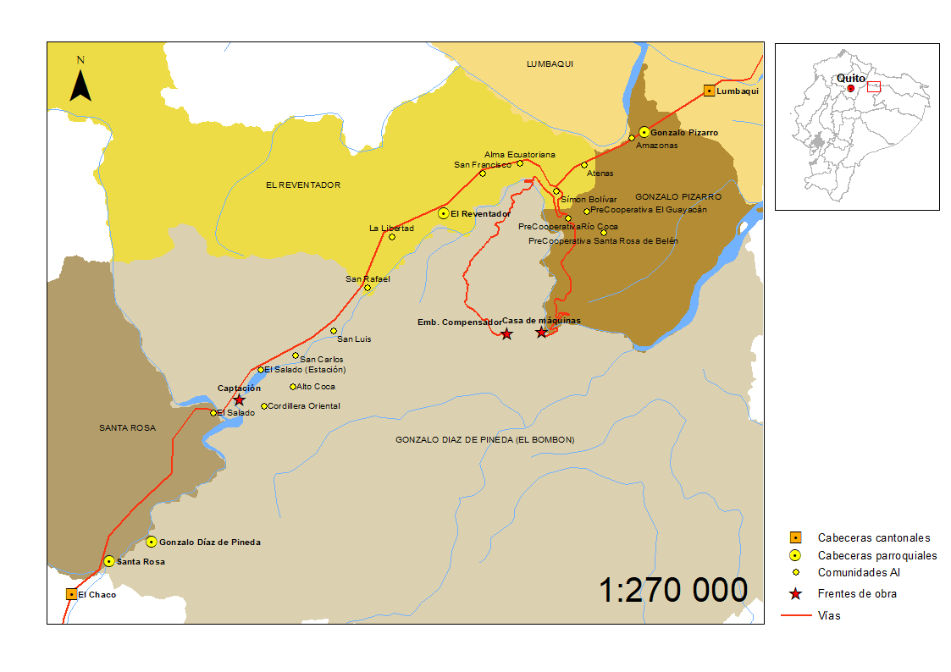
Coca Codo Sinclair Hydroelectric Project
Capacity: 1,500 MW
Annual generation: 8,734 GWh
Construction: Sinohydro
Implementation: CocaSinclair
Financing: China Eximbank
Total Cost: $ US 2,851 million
Affected zone: Napo River Basin, Coca River. Provinces of Napo and Sucumbíos (Amazonia), 3 km² flooded.
INEC (2017), IGM (2017)
Notes:
una zona de transición entre la Sierra y la Amazonía ecuatorianas.

Slide 31
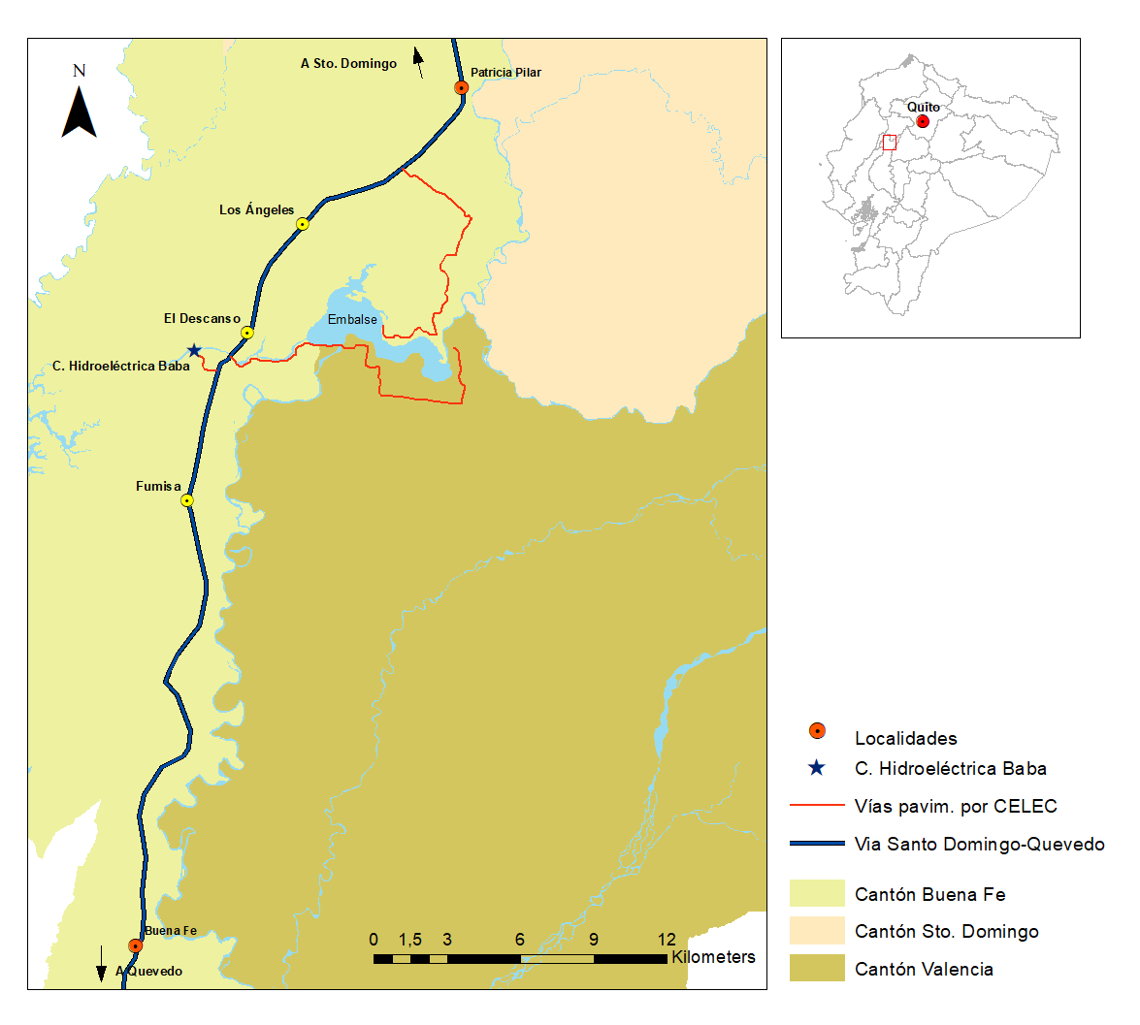

Baba Project
Multipurpose: flood control, irrigation for agro-products, electricity generation, repowering.
Capacity: 42 MW + 213 MW*
Annual generation: 161 GWh + 280 GWh*
Construction: OAS
Implementation: Hidrolitoral
Financing: State’s budget
Total Cost: $ US 542 million
Affected zone: Guayas River Basin, Baba River. Province of Los Ríos (Cost), 672 hectares flooded.
INEC (2017)
* Repowering

Slide 32
Baba Project
Multipurpose: flood control, irrigation for agro-products, electricity generation, repowering.
Capacity: 42 MW + 213 MW*
Annual generation: 161 GWh + 280 GWh*
Construction: OAS
Implementation: Hidrolitoral
Financing: State’s budget
Total Cost: $ US 542 million
Affected zone: Guayas River Basin, Baba River. Province of Los Ríos (Cost), 672 hectares flooded.
INEC (2017)
* Repowering

Slide 33
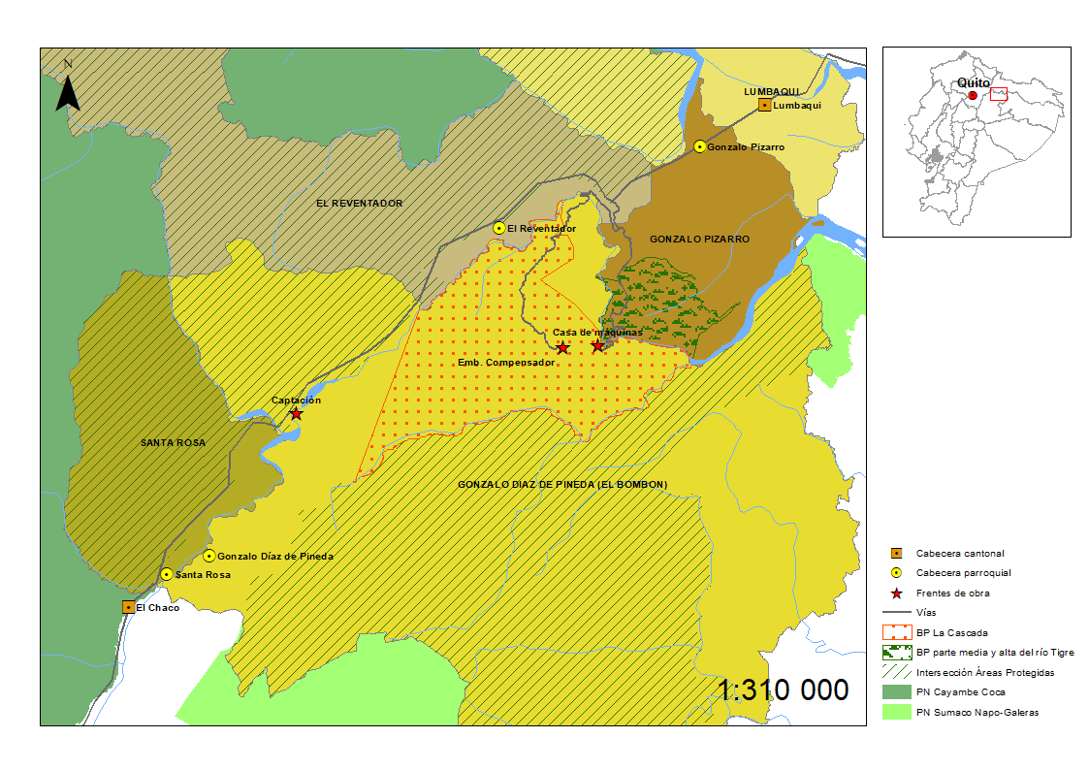
Safeguards are not actually applied
Projects are associated with:
significant environmental degradation.
social conflicts.
The presence of safeguards in both national legislation and Chinese regulations does not automatically consolidate a scheme of guarantees for the territories, the ecosystems and the affected populations.
Protected areas in the
Coca Codo Sinclair Project
INEC 2013

Slide 34
What aspects make the implementation of safeguards difficult?
Inadequate stakeholder engagement
Environmental impact assessments (EIAs) that do not incorporate all aspects of projects or all types of risks
Project governance that is lacking in transparency and accountability.

Slide 35
Inadequate stakeholder engagement
STATE
AFFECTED POPULATIONS
CHINESE ENTERPRISES
non-binding character of their environmental and social standards
dispersion of their regulations
environmental aspects are ignored and often result in negative impacts.
people are excluded from decision making processes.
correction of impacts in the most conflictive areas

Slide 36

EIAs that do not incorporate all aspects of projects or all types of risks.
Coca Codo Sinclair Project
RISKS IGNORED |  | POSSIBLE IMPACTS
Seismic and volcanic risks |  | Damages in infraestructure
Accumulation of sediments |  | Loss of aquatic biodiversity
Erosive potential of flow discharges after its use |  | Landslides
Neglect an integrated management of the basin and cumulative impacts by other projects |  | Cumulated impacts throughout the entire Amazon basin
Dispense with a part of the area of influence |  | Transfer local impacts to other areas
Impacts on the San Rafael waterfall |  | Impacts on touristic activities

Slide 37
EIAs that do not incorporate all aspects of projects or all types of risks.
Multi-purpose Baba Project
RISKS IGNORED |  | POSSIBLE IMPACTS
Inadequate control of the growth of aquatic weeds |  | Vector insects could be attracted and put nearby populations at risk
Insufficient monitoring and studies on the fish fauna affected by the project |  | Impacts for downstream populations

Slide 38
Project governance that is lacking in transparency and accountability
The State has a double role in these projects. On the one hand, it is sponsor of compliance with regulations through its institutional organization. On the other hand, the State executes projects and must comply with these regulations. In such conditions, compliance with labor and safety standards, as well as environmental standards, is only partial.
The difficult access to information is a constant, despite the existence of legislation that regulates institutional transparency.

Slide 39
Project governance that is lacking in transparency and accountability
Basic processes of environmental monitoring do not show continuity or are not carried out. The most notorious impacts are the loss of biodiversity and the growing shortage of species to fish.
Affected populations are excluded from decision making. The existing interlocution mechanisms are not very efficient to gather the concerns of the populations surrounding the projects. They are managed from a strategy that relegates the communities to a position of receiving information.

Slide 40
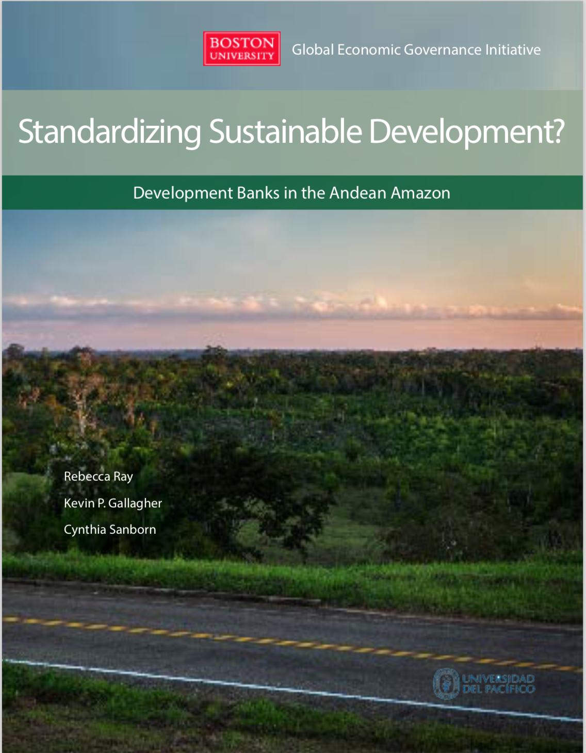
THANK YOU!
Download full report and subscribe to regulate updates:
www.bu.edu/GDP

